Slide 1



3D Educational Web Platform VisioScience3D
Student: Dragomir Andrei-Mihai
Scientific advisor: Prof. Dr. Ing Anca Morar
Sesiunea de Comunicări Stiințifice Studențești – SCSS 2025, 12-13 mai 2025
>

Slide 2

Introduction
After careful research and consideration of the available educational platforms, we concluded that there are no all-in-one, Romanian language-based solutions for students at middle and high school level that presents science subjects in a creative and appealing manner and offers professors a way to create quick evaluation quizzes.
<
>

Slide 3
Purpose
The platform offers an interactive 3D menu and educational 3D hubs for different basic science subjects. Its purpose is to be a quick and easy to use companion for students and professors looking to interact with a 3D modellable science lessons. It currently offers a role-based account system with quiz creation and student results management tool. It also has a self developed affiliate market for science books.
<
>

Slide 4



Market research and SoA
phet.colorado.edu
Limitations:
Lacks evaluation support.
Provides limited visuals.
Only shows basic models and no computer science or astronomy support.
invatamate.com
Limitations:
Suboptimal user experience.
Limited visuals and focus on materials and external Kahoot integrated quizzes.
mozaweb.com
Limitations:
Good selection of visuals but needs external plugin for them.
The focus is marketplace rather than open education.
iqboard.ro
Limitations:
Good selection of 2D and 3D visuals on various topics but separate products with very high price (basic 284€, expert 321€).
<
>

Slide 5
Functional requirements
Student Features:
Account Creation & Authentication
Access to science interactive menu
Interacting with 3D visuals and adding chemistry formulas via the engine
Profile Management
Quiz attempting and results visualization
Professor Features:
Account Creation & Authentication
Access to science interactive menu
Interact with 3D visuals
Profile Management
Quizzes creation and management
Class and student management
Student results aggregation, management and exporting
<
>

Slide 6
Non-functional requirements
Performance :
User Experience: Fast, smooth interactions to keep users engaged.
Requests to Backend: Ensure low latency in API calls to backend microservices.
Frontend Loading: Leverage framework preloading and caching for near-instant canvas render.
Evaluation: Utilization of testing tools and manual testing.
Architecture: Kubernetes-backed microservices distributing load and isolating failures.
Reliability:
Codebase Integrity: Clean, readable code to minimize bugs
Metrics: Expose health metrics to Grafana.
Evaluation: Enforce gofmt and static analysis tools on code.
Routing: Use Kong for unified routing, auth, rate-limiting, load balancing and observability.
<
>

Slide 7

Proposed solution
Main interactive 3D menu:
Math: 3D geometry.
Physics: Fundamental mechanics problems.
Chemistry: Interactive molecule engine uploader and visualizer.
Astronomy: Solar system and planets 3D visuals and metrics.
Algorithmics: C++ interactive 3D data structures engine.
For Professors:
Classes: Manager of classes and students via email.
Quizzes: Quiz creation engine and results per student.
Analytics: In-depth statistics and analysis on student results.
Tracking: Attendance reports with logins, quiz attempts or time spent in modules.
Gamification & Achievements: Badges, leaderboards or “streaks”.
Marketplace:
Book market: External marketplace for science and exercise books on the subjects presented.
<
>

Slide 8
Implementation
Frontend
JavaScript: ReactJS (Frontend), ThreeJS (3D framework using WebGL)
Backend
Technology: Go with Gorilla mux
Architecture: K8s with Kong router
Measure: Grafana + Prometheus
Cluster Manager: Portainer
Database
Database: MongoDB with Mongo Express manager
Authentication System
Tokens: JWT for Access and Refresh Tokens
Validity: Access Token (15 minutes), Refresh Token (7 days)
<
>

Slide 9
Current progress
Role based account system (students and professors)
Main interactive 3D menu
Educational 3D hubs for math, physics, chemistry, astronomy and computer science
Classes management
Quiz creation and management
Functional marketplace
<
>

Slide 10
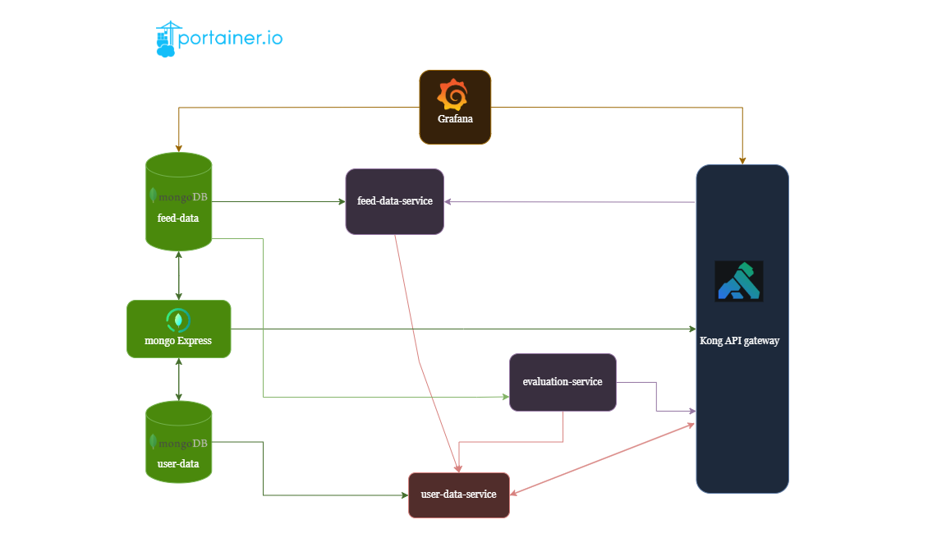
Backend Architecture
<
>

Slide 11
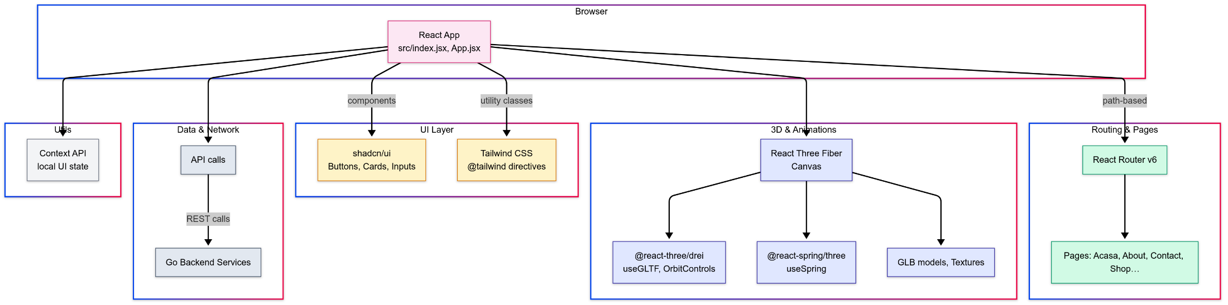
Frontend Architecture
<
>

Slide 12
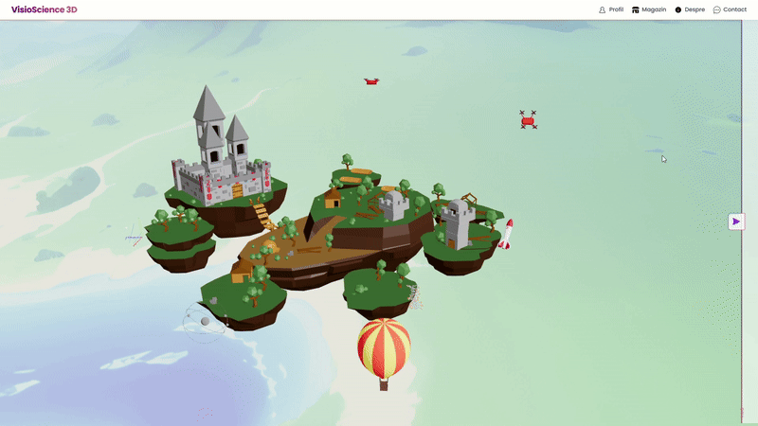
3D Scenes
Canvas
We wrap every 3D scene in a Canvas from @react-three/fiber, configuring camera, lighting, and performance.
GLTF conversion
GLB files are converted to React-ready hooks via gltf.pmnd.rs, giving us useGLTF() components.
Animations
We use react-spring/three for continuous animations.
Physics & Controls
For physics-like behavior (drag inertia, damping) we compute deltas manually in useFrame.
<
>

Slide 13
Evaluation
Manual QA & Testing
Manual testing for bugs and problems in developer defined scenarios.
Loaded GLB assets (planets, geometry, molecules, data structures) in isolation and via the menu to confirm they appeared correctly (no missing meshes, textures or materials).
Tested orbit/zoom/move via mouse, touch to ensured smooth experience.
CI/CD Pipelines
Every PR runs linters (gofmt), set-up, build tests, and unit tests will be added.
Performance Benchmarks
Target for final version: Latency: API < 100 ms, model‐load FPS ≥ 30.
<
>

Slide 14
Problems
Backend & Kubernetes Ingress:
Kong’s Ingress Controller isn’t accessible locally by default, so we ran a port-forward to expose it.
Exposing microservices via Kong meant aligning containerPort / targetPort, ClusterIP services, and Ingress annotations.
CI/CD Build & Rollout Workflow for each change:
We rebuild and push the container each time, then trigger a rollout and watch until the new pods are up and running before the old ones go away—so updates happen without downtime but build and deploy takes time.
GPU memory exhaustion from massive textures
Our initial Earth model and background maps were in the 16 K×8 K range, which routinely blew out WebGL’s memory (context lost, shader errors, down-resizing warnings).
We solved it by swapping in 4 K–8 K variants, lazy-loading, and using compressed formats where possible.
<
>

Slide 15
Next steps
User retention and experience: Add badge/leaderboard support in the quiz engine.
Observability & Health: Instrument frontend and backend with Prometheus metrics, hook up Grafana dashboards for real-time health and usage tracking.
Professor utils best effort: Add exporting functionality in leaderboards, email notifications for upcoming quizzes, due dates, or performance reviews, export session logs and 3D module usage, LLM integration for educational support, analytics filters.
<
>

Slide 16
Demo
<
>

Slide 17
Thank you! Any questions?
<

